Slide 1

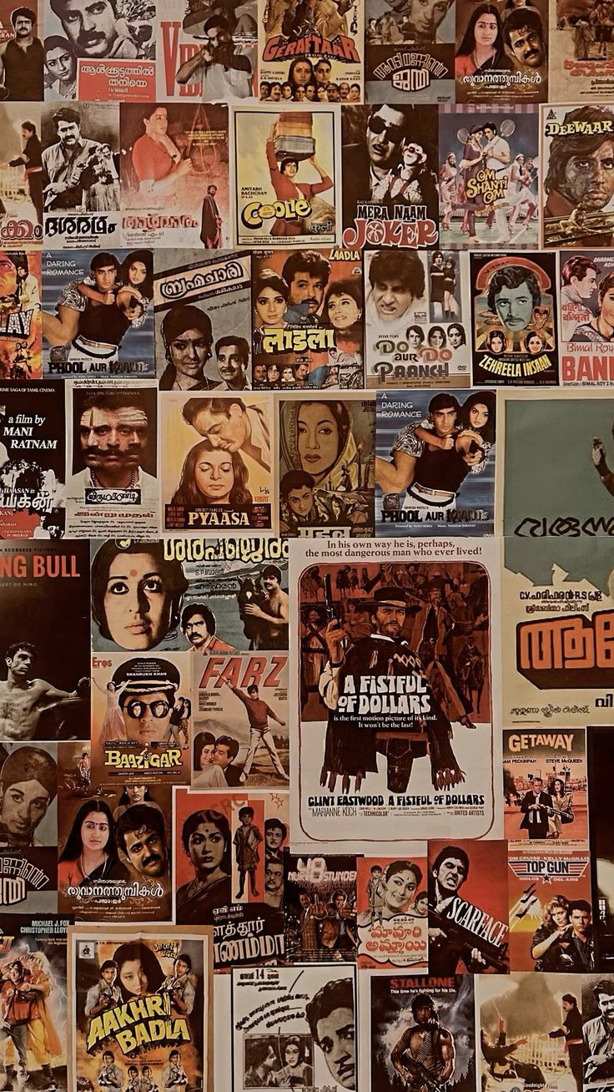

Data Analysis of

Slide 2

Overview
Conducted a detailed analysis and visualization of the Disney+Hotstar dataset to extract meaningful insights and trends related to movie genres, running times, release years, age ratings, and other attributes.
Investigated the distribution and patterns within the dataset to provide a clear understanding of various movie attributes and trends.

Slide 3

Scope
Identifies key genres to guide strategy
Crafting targeted audience for outreach
Reveals trends for targeted marketing campaigns
Analyzes trends for informed production decisions

Slide 4

KEY ANALYSIS

Slide 5
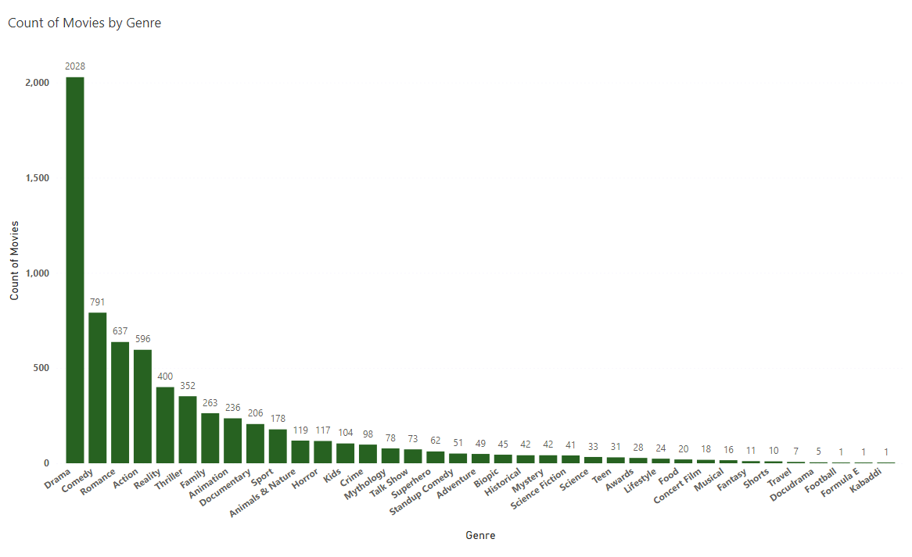
Distribution of Movies by Genre

Slide 6
Distribution of Movies by Genre
Top 5 | Top 5
Genre | Count of Movies
Drama | 2028
Comedy | 791
Romance | 637
Action | 596
Reality | 400
Drama, Action, and Romance clearly stand out
Long tail of genres are having low movie counts which indicates limited diversity
Genres like Sports, Animals & Nature, and Documentaries have very few movies, suggesting potential for expansion

Slide 7
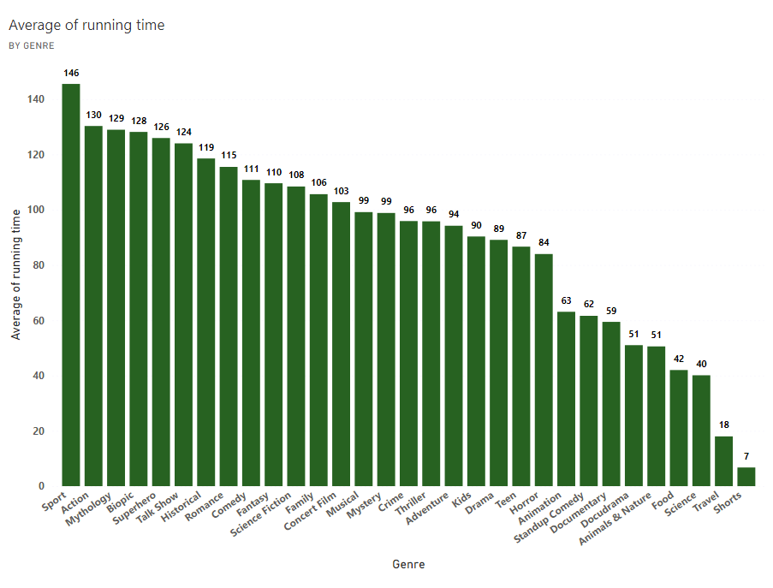
Average Running Time by Genre

Slide 8
Average Running Time by Genre
Top 5 Genre with highest run-time | Top 5 Genre with highest run-time
Genre | Average of running time
Sport | 145.5
Action | 130.28
Mythology | 128.93
Biopic | 128.14
Superhero | 125.93
Sports, Action, and Mythology genres have significantly longer average running times
Documentaries, Food, and Shorts genres have considerably shorter average running times
There's a wide range of average running times across genres, indicating diverse content consumption habits among viewers

Slide 9
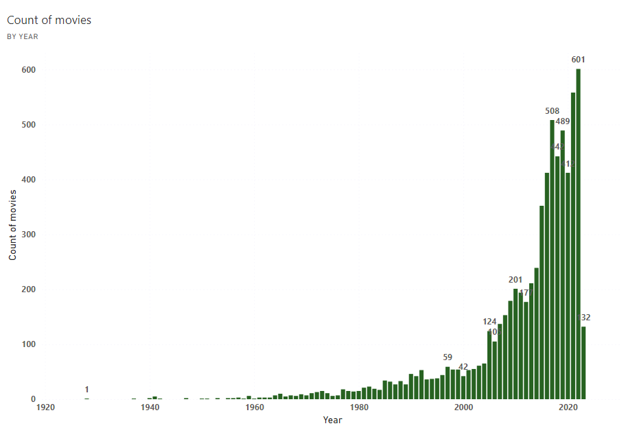
Movies Released Each Year

Slide 10
Movies Released Each Year
Top 5 years | Top 5 years
Year | Count of movies
2022 | 601
2021 | 558
2017 | 508
2019 | 489
2018 | 442
The number of movies increases exponentially from the 1980s, with a significant spike in the 2000s and 2010s
Older movies, especially from the 1920s to 1970s, are significantly underrepresented.
The platform has seen substantial growth in recent years, with the highest count of movies in the 2020s

Slide 11
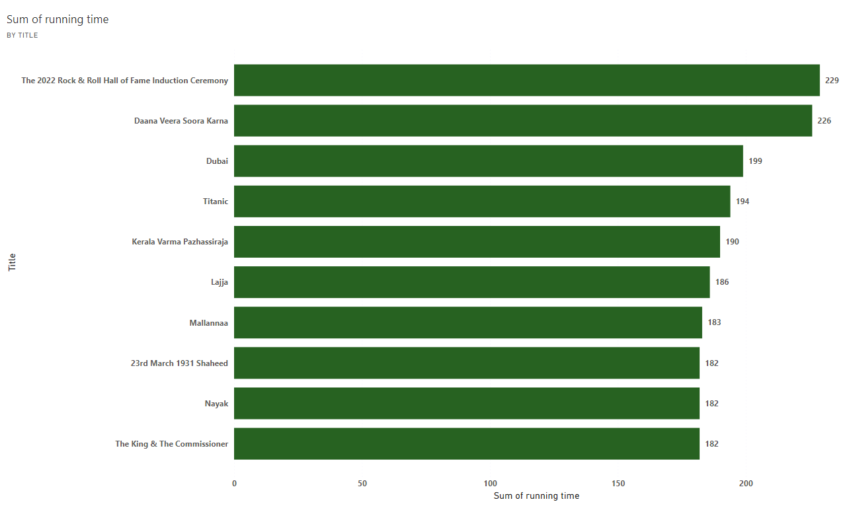
Top 10 Longest Movies

Slide 12
Top 10 Longest Movies
Top 5 movies with highest run-time | Top 5 movies with highest run-time
Title | Run-time
The 2022 Rock & Roll Hall | 229
Daana Veera Soora Karna | 226
Dubai | 199
Titanic | 194
Kerala Varma Pazhassiraja | 190
The 2022 Rock & Roll Hall of Fame Induction Ceremony" holds the longest cumulative running time
There's a considerable difference in total running time between top-ranking titles and others, indicating diverse content lengths.
The chart features a limited number of data points, suggesting potential for expanding the analysis to include more titles

Slide 13
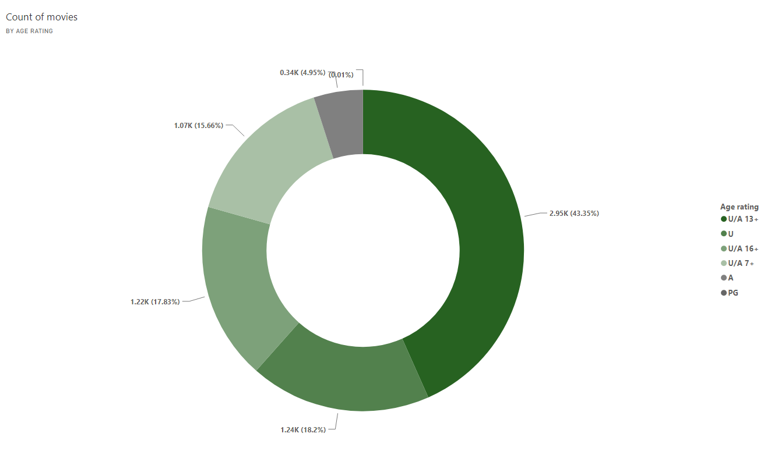
Movies by Age Rating

Slide 14
Movies by Age Rating
Age rating | Count of movies
U/A 13+ | 2954
U | 1240
U/A 16+ | 1215
U/A 7+ | 1067
A | 337
PG | 1
U/A 13+ constitutes the largest portion of the content, indicating a significant audience in this age group
U and U/A 7+ ratings also hold substantial shares, highlighting the platform's focus on family-friendly content.
The A rating segment is relatively small, suggesting limited content for adult audiences

Slide 15
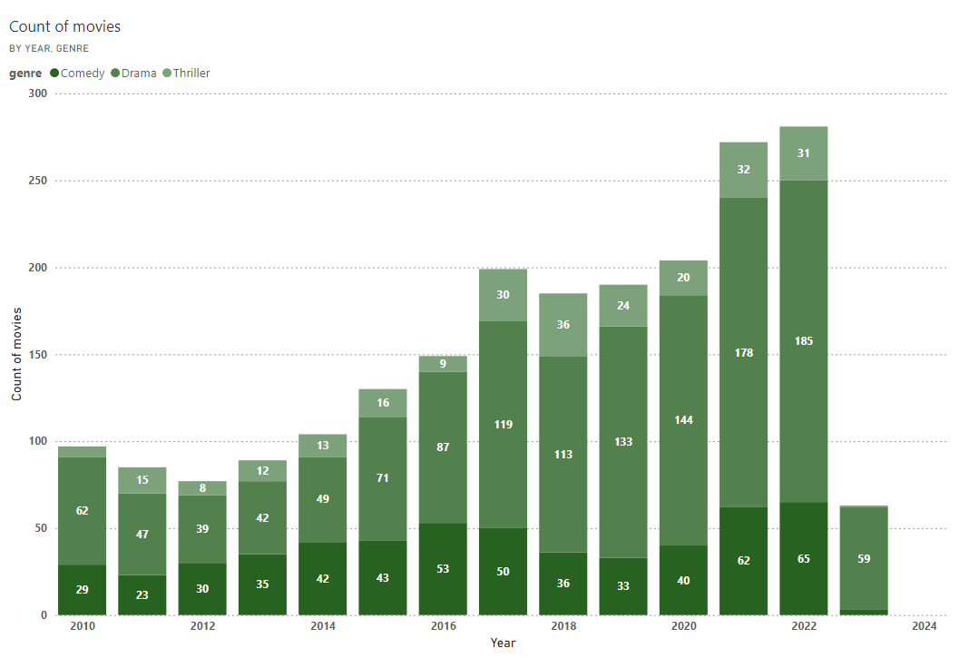
Count of Movies by Year and Genre

Slide 16
Count of Movies by Year and Genre
Genre Peak in respective year | Genre Peak in respective year | Genre Peak in respective year
Year | Genre | Count of Movie
2022 | Drama | 185
2022 | Reality | 67
2019 | Sport | 65
2022 | Comedy | 65
2017 | Action | 55
Drama consistently dominates across all years, with a significant increase in recent years. Comedy and Thriller counts have also grown steadily
The overall number of movies has increased significantly from 2010 to 2022, with 2022 witnessing the highest count
While Drama dominates, Comedy and Thriller genres have shown consistent growth, indicating a balanced content strategy
Software

Slide 17
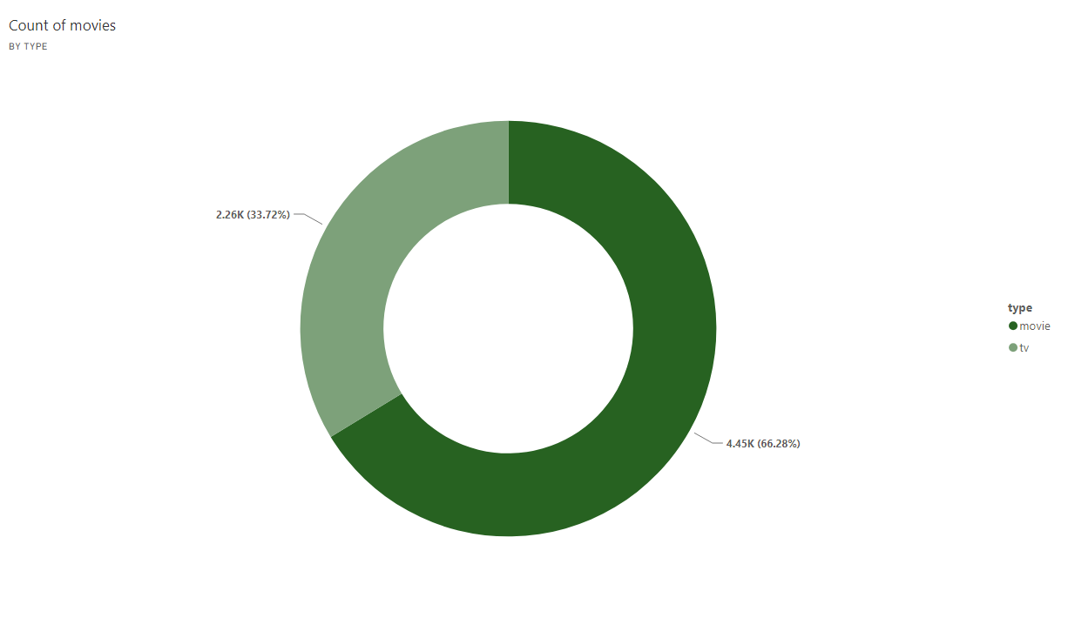
Most Common Movie Types

Slide 18
Most Common Movie Types
Type | Count of movies
Movie | 4446
Tv (Series) | 2262
Movies hold a significantly larger share compared to TV shows, indicating a stronger focus on films
While movies are predominant, the presence of TV shows suggests a balanced content strategy
The chart offers a high-level overview but lacks details on specific movie or TV show characteristics
Software

Slide 19
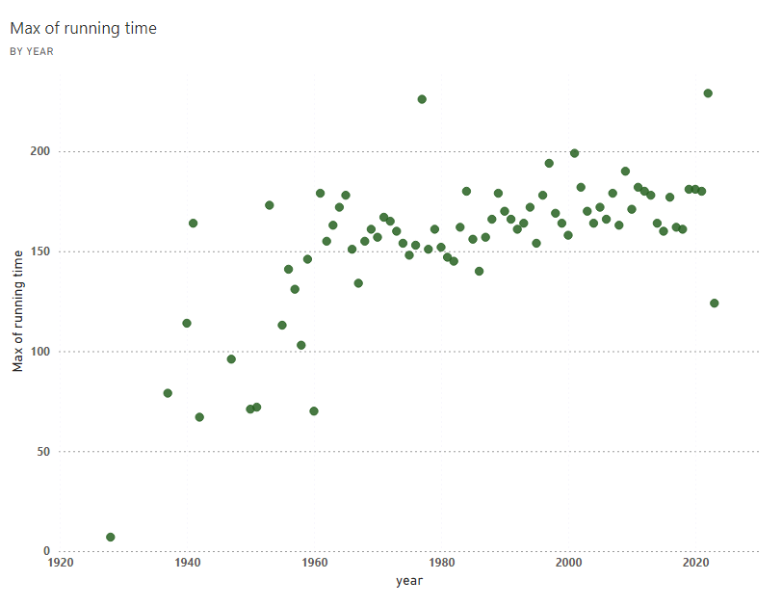
Correlation Between Running Time and Year

Slide 20
Correlation Between Running Time and Year
Top 5 Max running time | Top 5 Max running time
Year | Max of running time
2022 | 229
1977 | 226
2001 | 199
1997 | 194
2009 | 190
Maximum running time exhibits variability across years, with peaks in the 1980s and 2010s
A general downward trend is observable from the 2010s onward, suggesting a shift towards shorter content formats
A few data points deviate significantly from the overall pattern, indicating potential outliers or unique content pieces
Software

Slide 21
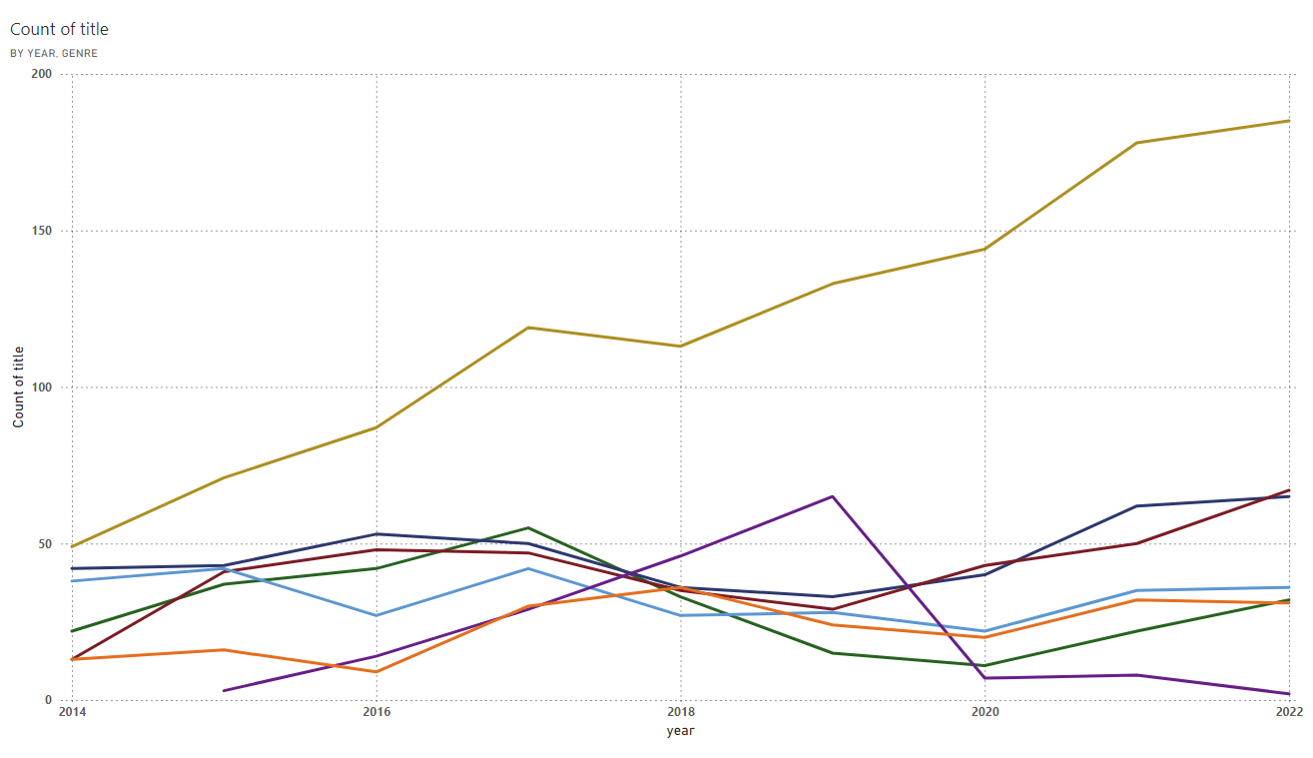
Genre Popularity Over Time

Slide 22
Genre Popularity Over Time
Genre Peak in respective year | Genre Peak in respective year | Genre Peak in respective year
Year | Genre | Count of Movie
2022 | Drama | 185
2022 | Reality | 67
2019 | Sport | 65
2022 | Comedy | 65
2017 | Action | 55
A clear upward trend in title count is evident across most genres since 2014, indicating platform expansion
Drama and Action consistently have higher title counts compared to other genres. Some genres like Comedy and Thriller show fluctuations in title count over the years
The chart provides a high-level overview but lacks details on specific title characteristics like language or region
Software

Slide 23
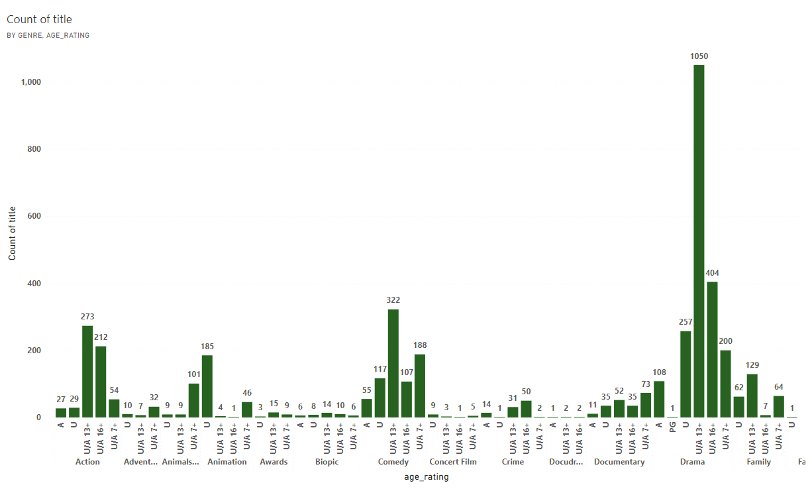
Movies by Genre and Age Rating

Slide 24
Movies by Genre and Age Rating
Age rating based movies in each year | Age rating based movies in each year | Age rating based movies in each year
Genre | Age rating | Count of movie
Drama | U/A 13+ | 1050
Romance | U/A 13+ | 374
Comedy | U/A 13+ | 322
Action | U/A 13+ | 273
Reality | U/A 13+ | 199
Drama and Action genres have the highest number of titles across most age ratings
U/A 13+ is the most common age rating for a majority of genres. There's a significant disparity in title counts across genres, with some genres having minimal representation
Certain genre-age rating combinations have notably higher title counts, indicating potential audience preferences
Software

Slide 25

Decoding ‘Drama’

Slide 26
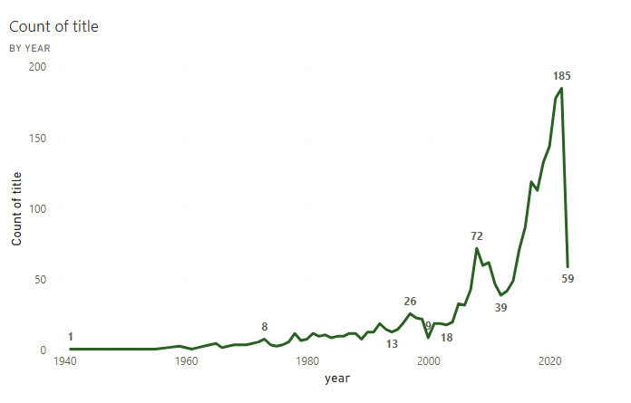
The ‘Drama’tic movie over years

Slide 27
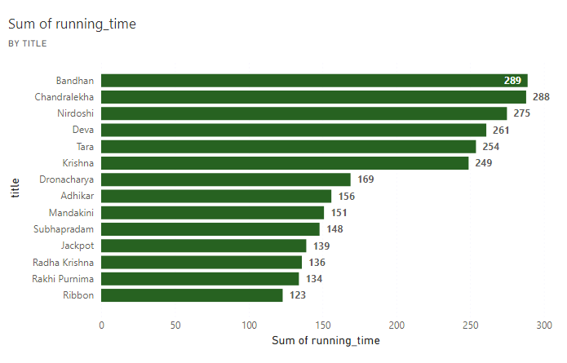
Avg running time of Drama Movies

Slide 28
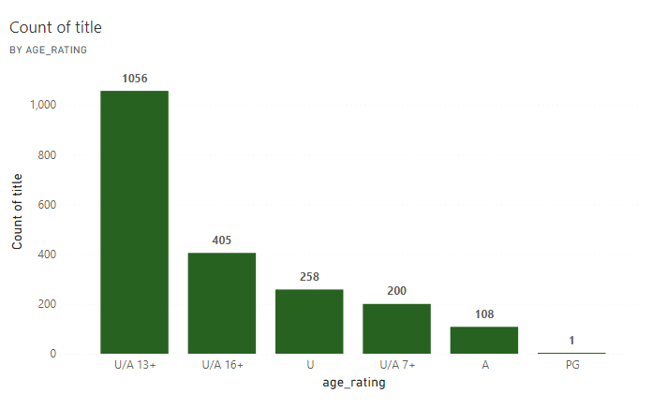
Drama Movies vs Age Ratings

Slide 29
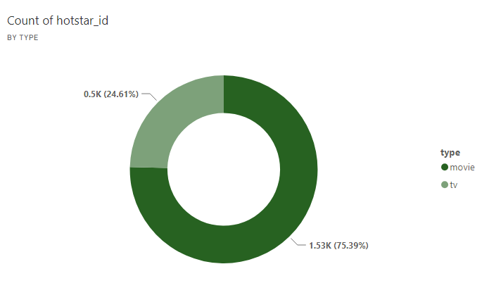
Classification of Drama movies

Slide 30
Decoding ‘Drama’
Content Growth: There is a substantial increase in content since the 1980s, peaking around 2010.
Age Rating: It is prevelant that U/A 13+ as the most prevalent age rating.
Content Type: The pie chart reveals a significant dominance of movies over TV shows.
Running Time: The run time chart highlights the long running times of top titles
Software

Slide 31
Way Forward
Content Focus and Expansion
Expand beyond dominant genres (Drama, Action, Romance) to cater to a wider audience. Address underrepresented genres and age ratings to balance the content library.
Audience Understanding
Prioritize content for the core U/A 13+ and U/A 7+ demographics while exploring adult content options. Analyze viewership data to understand content preferences based on genre, age, and other factors.
Software

Slide 32
Way Forward
Data-Driven Decision Making
Conduct in-depth genre analysis to understand growth potential and audience preferences.
Content Strategy
Prioritize acquiring content that complements the existing library and fills content gaps. Consider original content production to differentiate the platform and cater to specific audience segments
Software
Platform Evolution
Adapt to changing content trends and audience preferences over time.

Slide 33

Presented by Mohamed Afsar
Thank you very much!

